Slide 1
Predicting Parkinson's Disease Using Voice Recordings
PH 1976: Fundamentals of Data Analytics and Predictions
Instructor: Ashraf Yaseen
Group Member: Huiying Hu, Parminder Singh Kooner, Syeda Akter

Slide 2
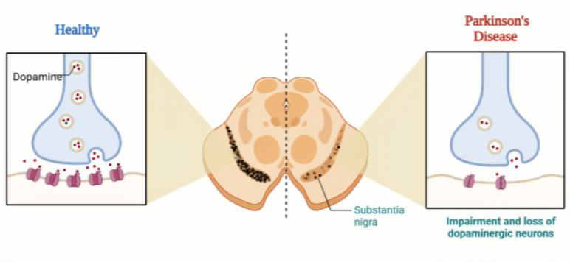
Background & Clinical Motivation
Parkinson's disease (PD) is a progressive neurodegenerative disorder caused by loss of dopaminergic neurons in the substantia nigra
~90% of PD patients develop vocal impairment: reduced loudness, irregular pitch, breathy speech
Speech is a motor function affected by the same circuits that control movement
Voice analysis is non-invasive, low-cost, and remotely deployable → ideal for early screening
Loss of dopaminergic neurons in the substantia nigra disrupts dopamine signaling at the synapse
Kufta, A. (2026) BioRender.

Slide 3
Dataset & Preprocessing
Source: Sakar et al. (2019) — Parkinson's voice recordings
Structure: 252 subjects × 3 recordings = 756 observations
Subject-level aggregation
Mean of 3 recordings per subject
Outcome = first observed class per subject (consistent across recordings)
Result: 201 train / 51 test, no missing values
High-correlation filter (cutoff = 0.90)
Reduced from 753 to 353 predictors
Z-score standardization: fit on training only

Slide 4
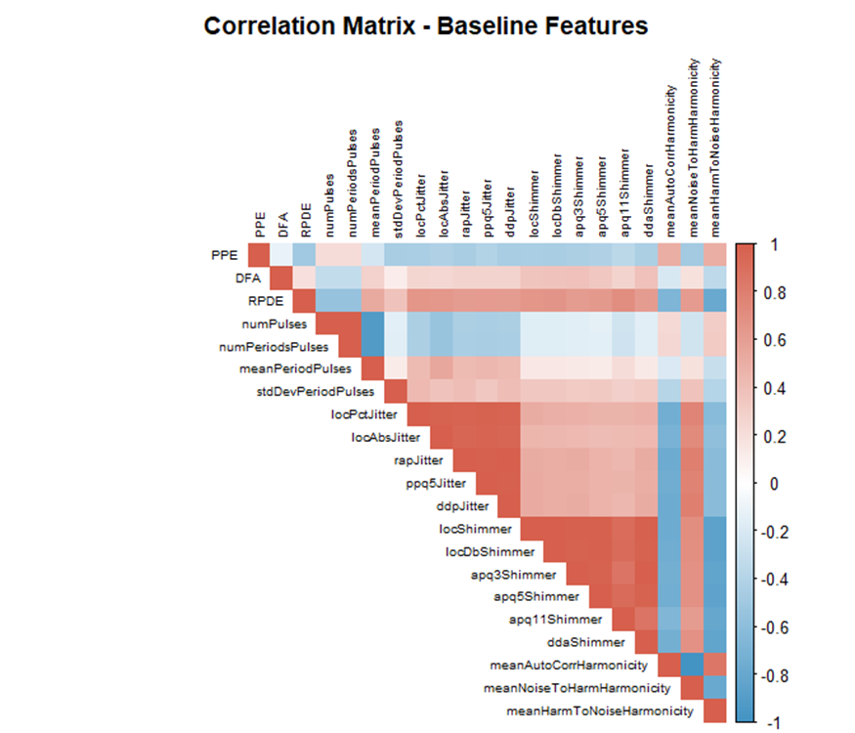
Feature Correlation and Two Preprocessed Versions
Acoustic features are highly redundant — MFCC, wavelet, and TQWT bands carry overlapping information
Correlation matrix of the 753 features reveals dense clusters of highly correlated predictors
Different model families have different needs:
Logistic regression is sensitive to multicollinearity → coefficient variance inflation, unstable optimization
Tree-based & kernel methods (RF, SVM, MLP) handle correlated features natively

Slide 5
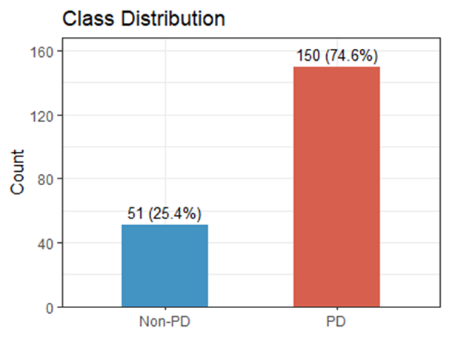
Exploratory Findings
Training set: 150 PD / 51 Non-PD (n = 201), roughly 3 : 1
A trivial "predict all PD" classifier achieves 75% accuracy with 0% specificity — high accuracy, zero diagnostic value
Reporting AUC, sensitivity, and specificity together instead of accuracy alone Applying up-sampling within CV folds during training to balance classes

Slide 6
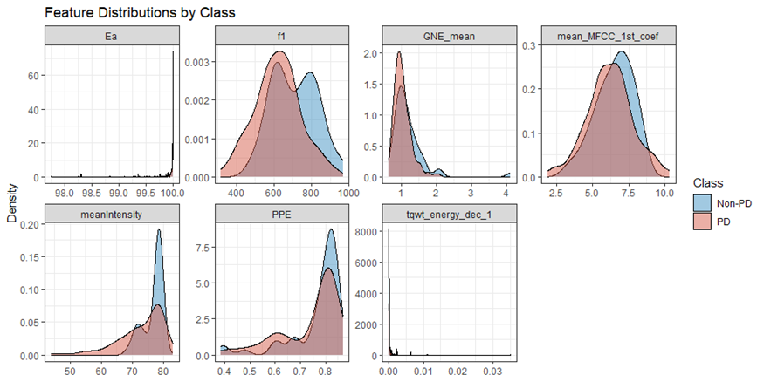
Exploratory Findings
Examined 753 individual features against PD vs Non-PD class Most features overlap heavily between groups (e.g., mean_MFCC_1st_coef)
A few show modest separation (e.g., f1, PPE, GNE_mean), but none cleanly separates classes
No single feature works as a univariate diagnostic marker
PD signal is distributed across many weakly informative features, motivating multivariate ML instead of simple thresholding

Slide 7
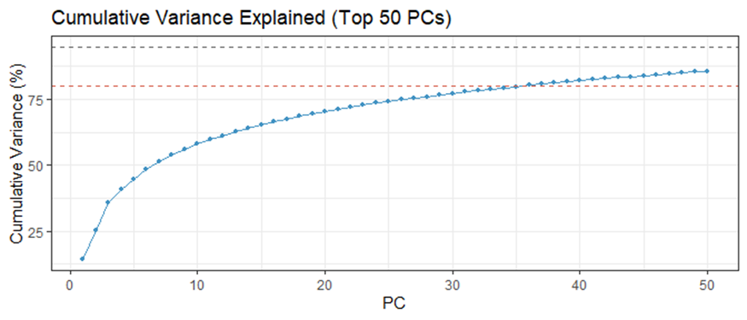
Dimensionality Reduction with PCA Findings
After correlation filtering, applied PCA to compress residual redundancy in the 353 features
First two components together explain only 25% of total variance (PC1: 14.2%, PC2: 11.1%)
Approximately 36 components needed for 80% of total variance
Variance is spread across many components, consistent with our EDA finding that PD signal is distributed across many features
Used as input for the MLP model

Slide 8
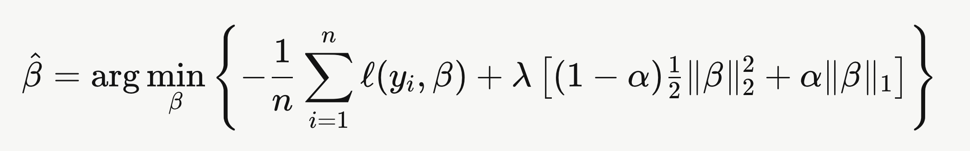
Modeling Approach: Four Classifiers
Model | Input | Hyperparameters | Rationale
Logistic Regression(glmnet) | 353 features | α = 0, λ = 0.1 | Linear baseline, ridge penalty handles residual collinearity, interpretable
Random Forest | 753 features | mtry = 15 | Capture non-linear interactions, provides features importance
SVM | 753 features | σ = 0.001, C = 5 | Non-linear decision boundary in high-dimspace
MLP | 36 PCs | Size = 5, decay = 0.1 | Non-linear, PCA input stabilizes training given p >n
Notes:
On this slide, we’re showing the four classification models we used to predict Parkinson’s disease.
From a statistical learning perspective, this is a supervised classification problem, where we’re trying to learn a function that maps our predictors—things like MFCC coefficients, wavelet features, and other voice-based measurements—to the probability of Parkinson’s disease.
We start with logistic regression, which is our baseline model. It estimates probabilities using a linear combination of predictors.
But because our dataset is high-dimensional and the predictors are highly correlated, we don’t just fit a standard model—we use regularization, specifically a ridge penalty, with α = 0 and λ = 0.1.
Mathematically, what we’re doing is minimizing a function that has two parts:
one part that measures how well the model fits the data
and another part that penalizes large coefficients
The penalty term in ridge regression shrinks all the coefficients toward zero.
And the reason this matters is that many of our predictors—like MFCC and wavelet features—are strongly correlated, so without regularization, the model would become unstable and overfit.
So ridge helps reduce variance and gives us more reliable estimates.
Moving to the other models—
Random Forest is an ensemble of decision trees. It reduces variance by averaging many trees, and we tuned mtry = 15, which controls how many predictors are considered at each split.
SVM uses a radial kernel, with σ = 0.001 and C = 5, allowing it to capture nonlinear relationships by finding an optimal boundary in a high-dimensional space.
And finally, the MLP neural network uses 36 principal components as input, with size = 5 and decay = 0.1. Neural networks are very flexible, but they require careful tuning, especially with smaller sample sizes.
So overall, we’re comparing models that range from simple and interpretable with regularization, to more flexible nonlinear methods, to see which best captures the structure in our data
Ridge is preferred over Lasso here because we expect many small but relevant predictors rather than a few strong ones, so shrinking all coefficients is more appropriate than selecting a subset.

Slide 9
Evaluation Framework
Performance estimation
All metrics computed via 5-fold cross-validation on the 201 training subjects
The 51-subject test set has no labels — used only to generate final predictions for course submission
Hyperparameters tuned within CV using grid search; final values reported in Methods slide
Metrics reported
AUC — overall ranking performance, threshold-independent
Sensitivity — recall on PD class (true positive rate)
Specificity — recall on Non-PD class (true negative rate)
Accuracy, F1 — reported for completeness, but de-emphasized given class imbalance
Notes:
Once we built the models, the next step is figuring out how to evaluate them properly.
We used 5-fold cross-validation on the 201 training subjects, which is important because it gives us a more reliable estimate of how the model will perform on new data.
From a statistical learning perspective, this helps us estimate test error, rather than just training error, which can be overly optimistic.
In terms of metrics, we report several:
AUC, which measures how well the model ranks PD versus non-PD across all thresholds
Sensitivity, which tells us how well we detect actual Parkinson’s cases
Specificity, which tells us how well we correctly identify non-Parkinson’s individuals
We also report accuracy and F1-score, but we don’t rely on them as much because our data is imbalanced.
So the key idea here is that no single metric is enough, especially in imbalanced classification problems, so we look at multiple metrics to get a complete picture.

Slide 10
Cross-Validated Performance Across Models
Model | AUC | Accuracy | Sensitivity | Specificity | F1
Logistic Regression (glmnet) | 0.859 | 0.811 | 0.840 | 0.725 | 0.869
Random Forest | 0.842 | 0.821 | 0.940 | 0.451 | 0.886
SVM | 0.796 | 0.806 | 0.967 | 0.314 | 0.881
MLP | 0.816 | 0.756 | 0.800 | 0.627 | 0.831
Logistic regression: highest AUC and best sensitivity-specificity balance
RF and SVM achieve very high sensitivity (≥0.94) but at the cost of low specificity — close to the "predict all PD" baseline
MLP underperforms — likely limited by hyperparameter search and small training set
Notes:
Here are the performance results across all four models:
Logistic Regression: AUC = 0.859, Accuracy = 0.811, Sensitivity = 0.840, Specificity = 0.725, F1 = 0.869
Random Forest: AUC = 0.842, Accuracy = 0.821, Sensitivity = 0.940, Specificity = 0.451, F1 = 0.886
SVM: AUC = 0.796, Accuracy = 0.806, Sensitivity = 0.967, Specificity = 0.314, F1 = 0.881
MLP: AUC = 0.816, Accuracy = 0.756, Sensitivity = 0.800, Specificity = 0.627, F1 = 0.831
What stands out is that logistic regression has the highest AUC and the most balanced performance, especially between sensitivity and specificity.
From a theory standpoint, this reflects the bias-variance trade-off.
Logistic regression is simpler, so it has slightly higher bias but lower variance
More flexible models like Random Forest and SVM have lower bias but higher variance
We can see that in the results—Random Forest and SVM have very high sensitivity, 0.94 and 0.967, but very low specificity, 0.451 and 0.314.
So they’re essentially predicting most observations as Parkinson’s, which gives high sensitivity but poor ability to detect healthy individuals.
So even though accuracy looks similar across models, logistic regression clearly provides the most reliable and balanced performance.

Slide 11
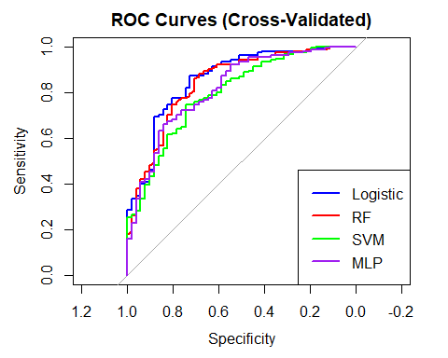
ROC Curves and Sensitivity–Specificity Trade-off
All four classifiers plotted in the same ROC space
Logistic and RF dominate at most operating points; SVM and MLP run consistently below
AUC ranking: Logistic 0.859 > RF 0.842 > MLP 0.816 > SVM 0.796
Performance gap is largest in the high-specificity region — the regime that matters for clinical screening
Notes:
This slide shows the ROC curves for all four models.
From a statistical learning perspective, the ROC curve plots sensitivity against 1 minus specificity across all possible thresholds.
The key summary measure is the AUC, where higher values indicate better ability to distinguish between classes.
In our results:
Logistic regression has the highest AUC at 0.859
Followed by Random Forest at 0.842
Then MLP at 0.816
And SVM at 0.796
What’s important here is that logistic regression’s curve stays above the others across most thresholds, especially in the high-specificity region, which is critical in clinical applications where false positives matter.
So the ROC curves reinforce that logistic regression has the strongest overall discrimination ability.

Slide 12
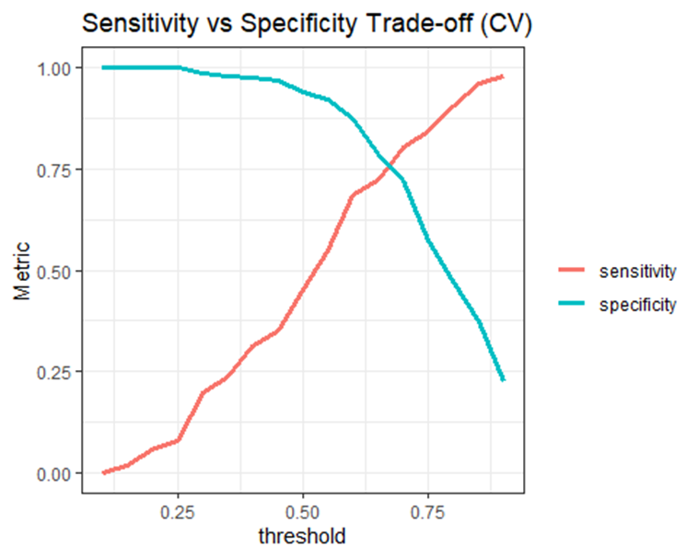
ROC Curves and Sensitivity–Specificity Trade-off
At the default 0.5 threshold: Sens = 0.840, Spec = 0.725
The threshold is tunable — it's a downstream policy decision, not a fixed model property
Lower threshold → higher sensitivity, lower specificity → suits population screening (catch every potential case)
Higher threshold → higher specificity, lower sensitivity → suits specialist triage (only flag high-confidence cases)
Logistic regression outputs a continuous risk score, allowing flexible deployment across clinical contexts
Notes:
This slide highlights the trade-off between sensitivity and specificity.
From theory, this trade-off comes from the fact that we’re choosing a classification threshold on predicted probabilities.
If we lower the threshold:
we classify more cases as positive → higher sensitivity, but lower specificity
If we raise the threshold:
we become more strict → higher specificity, but lower sensitivity
For logistic regression at the default threshold of 0.5:
Sensitivity = 0.840
Specificity = 0.725
The important takeaway is that the threshold is not fixed—it depends on the application.
For screening, we might prioritize sensitivity so we don’t miss any PD cases
For clinical confirmation, we might prioritize specificity to avoid false positives
So the model gives us probabilities, and the threshold becomes a decision-making tool, depending on the context.

Slide 13
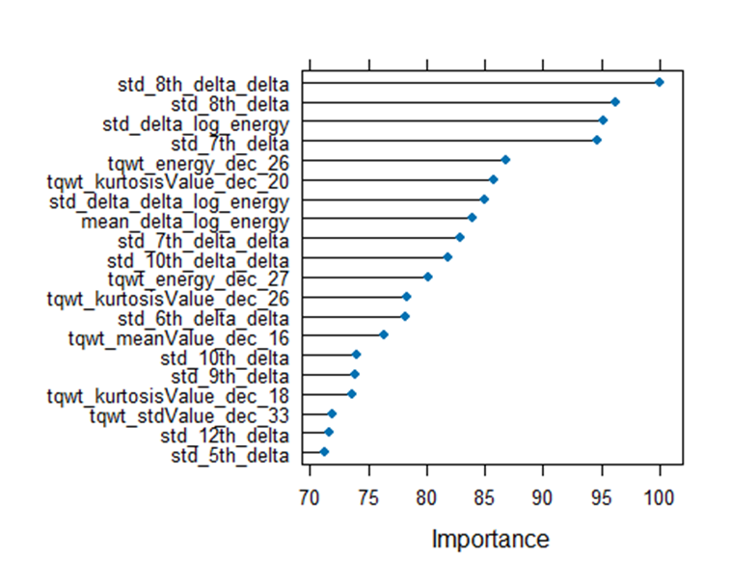
Most Informative Features (Random Forest)
Random Forest provides feature importance via mean decrease in accuracy when each variable is permuted
Top-ranked features cluster in two acoustic families: Delta-energy features, capture frame-to-frame changes in spectral energy
TQWT wavelet features, multi-scale frequency-band energy and shape
Both reflect temporal dynamics and fine-grained spectral irregularity — consistent with PD vocal motor impairment
No single feature dominates — top features have similar importance scores, reinforcing the multivariate signal hypothesis

Slide 14
Discussion
Best model: Logistic regression with ridge penalty. Highest CV AUC (0.859) and best Sens/Spec balance
Complex models traded specificity for sensitivity. RF and SVM behavior approached the "predict all PD" baseline rather than learning a balanced boundary
Simplest model won, consistent with small-n, high-p biomedical classification, where regularized linear models often match or beat complex alternatives
Top features (delta-energy, TQWT wavelet) plausibly reflect reduced energy variability and spectral irregularity from impaired laryngeal motor control
Voice-based screening: non-invasive, low-cost, scalable. Useful for triage, not standalone diagnosis

Slide 15
Limitation and Conclusion
Small sample size (n = 201 training subjects) limits generalizability and complex model performance
Class imbalance (3:1 PD:Non-PD) may bias models toward the majority class despite up-sampling
No external validation — test set has no labels; CV is our only performance estimate
Limited hyperparameter tuning, especially for MLP — broader grid search may shift rankings
Logistic regression with ridge penalty achieved the best CV AUC (0.859) with balanced sensitivity (0.84) and specificity (0.73)
Voice-based classification is a promising, low-cost screening modality for PD — not a replacement for clinical examination
Future work: larger cohorts, longitudinal recordings, external validation across recording devices

Slide 16
Q & A

